Slide 1
Longitudinal Data Analysis with the Multilevel Model for Change

Slide 2
Overview
The longitudinal dataset
Structure
Example we will use
The multilevel model
Formula
description
Example in R
Model
Plot

Slide 3
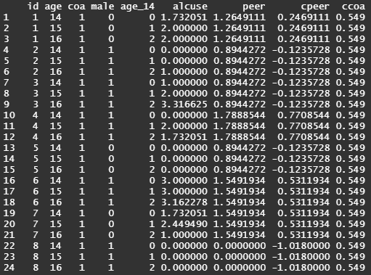
The Longitudinal dataset
Person-Period structure is considered optimal
Can have time varying and time invariant variables
Important features to model change
3 or more waves
An outcome whose values change systematically over time (time varying)
Sensible metric for clocking time

Slide 4
The Longitudinal dataset
Changes in adolescent alcohol use
3 waves of 82 adolescents each year beginning at age 14
COA = child of alcoholic parent
PEER = measure of alcohol use among the adolescent’s peers
ALCUSE = measure of an adolescent's alcohol use
Age_14 is the time variable used (age – 14)
How does COA and PEER affect ALCUSE over time?

Slide 5

The Multilevel model for change
Level 1 model – individual growth
$Y_{ij}=β_{0i}+β_{1i}{TIME}_{ij}+ε_{ij}$
Level 2 sub model – fixed effects/interindividual change
$β_{0i}= γ_{00}+γ_{01}{COA}_{i}+γ_{02}{PEER}_{i}+ζ_{0i}$
$β_{1i}= γ_{10}+γ_{12}{PEER}_{i}+ζ_{1i}$

Slide 6
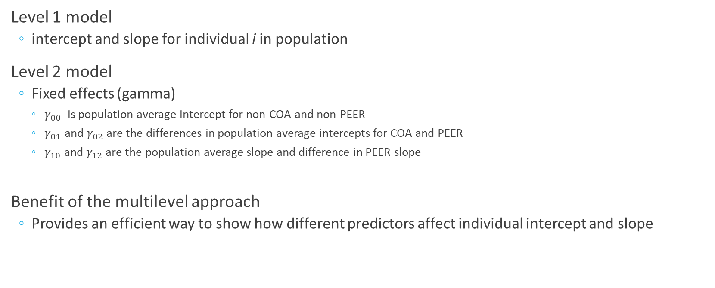
The Multilevel model – in words
Level 1 model
intercept and slope for individual i in population
Level 2 model
Fixed effects (gamma)
$γ_{00}$ is population average intercept for non-COA and non-PEER
$γ_{01}$ and $γ_{02}$ are the differences in population average intercepts for COA and PEER
$γ_{10}$ and $γ_{12}$ are the population average slope and difference in PEER slope
Benefit of the multilevel approach
Provides an efficient way to show how different predictors affect individual intercept and slope

Slide 7
Modeling in R
library(nlme)
Linear and nonlinear mixed effects models
lme() function
lme(alcuse ~ coa+peer*age_14 , data=alcohol1, random= ~ age_14 | id, method="ML")
lme(model with fixed effects, data, random effects | grouping, method is maximum likelihood)
nlme()
Nonlinear – maybe in another presentation…

Slide 8
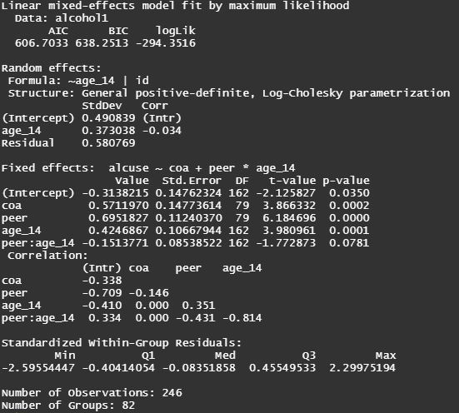
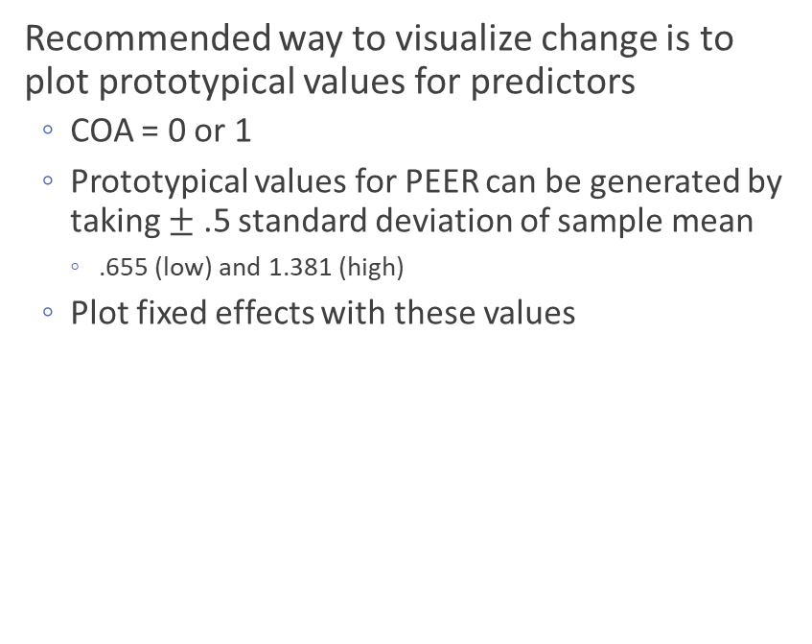
Modeling in R
Recommended way to visualize change is to plot prototypical values for predictors
COA = 0 or 1
Prototypical values for PEER can be generated by taking $±$ .5 standard deviation of sample mean
.655 (low) and 1.381 (high)
Plot fixed effects with these values

Slide 9
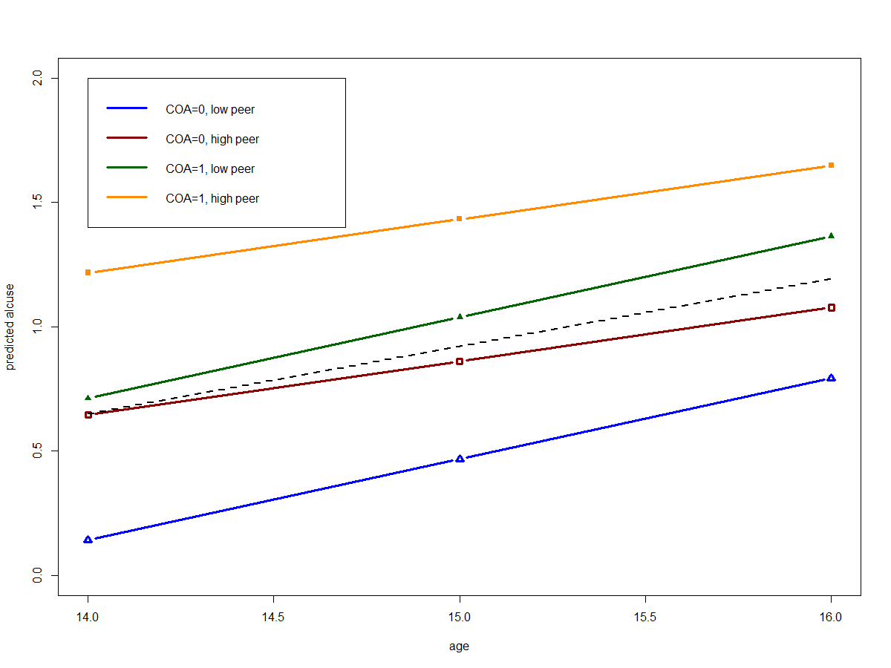

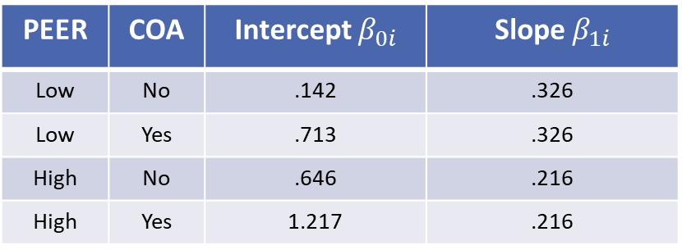


Modeling in R
How does COA and PEER affect ALCUSE over time?
PEER | COA | Intercept $β_{0i}$ | Slope $β_{1i}$
Low | No | .142 | .326
Low | Yes | .713 | .326
High | No | .646 | .216
High | Yes | 1.217 | .216
$$−.314+.571\left(1\right)+.695\left(1.381\right)$$
$$.425−.151(1.381)$$
$$β_{0i}= γ_{00}+γ_{01}{COA}_{i}+γ_{02}{PEER}_{i}$$
$$β_{1i}= γ_{10}+γ_{12}{PEER}_{i}$$

Slide 10
References
Applied Longitudinal Data Analysis by Singer and Willett
Applied Longitudinal Data Analysis, Chapter 4 | R Textbook Examples (ucla.edu)
nlme: Linear and Nonlinear Mixed Effects Models (r-project.org)

